Slide 1

Lending Club Case Study
Naga Manasa Surikuchi
Sriram Mannam

Slide 2
Table of Contents
1. Problem Details
2. Understanding and Objective
3. Approach and Methodology
4. Data Cleaning and Handling
5. Data Analysis
6. Conclusion

Slide 3
Problem Details
A consumer finance company which specializes in lending various types of loans to urban customers, wants to minimize the risk of going into credit loss. The main focus is on the loss occurred when the borrower refuses to pay or runs away with the money owed.
The company wants to understand the driving factors behind loan default, i.e. the variables which are strong indicators of default. The company can utilize this knowledge for its portfolio and risk assessment.
Data Provided:
The loan information about past loan applicants and whether they ‘defaulted’ or not is provided along with other details about the applicants.

Slide 4
Understanding & Objective
Understanding:
When the company receives a loan application, the company has to make a decision for loan approval based on the applicant’s profile. Two types of risks are associated with the bank’s decision:
If the applicant is likely to repay the loan, then not approving the loan results in a loss of business to the company
If the applicant is not likely to repay the loan, i.e. he/she is likely to default, then approving the loan may lead to a financial loss for the company
Objective:
Analyze and Understand how consumer attributes and loan attributes influence the tendency of default.

Slide 5
Approach & Methodology
In order to achieve meaningful insights about the data and the driving factors for loan defaulters, EDA ( Exploratory Data Analysis) has to be performed on the given Dataset.
Below are the methods applied in the course of analysis.
Read Data
Remove Null value columns
Remove irrelevant columns
Treat Missing data
Treat Outliers
Derive columns
Univariate Analysis
Segmented Data Analysis
Bivariate Analysis
EDA Analysis

Slide 6
Data Cleaning and Handling
The dataset given has 111 columns and 39717 rows.
There are 54 columns with null values. Removed all the columns as they don’t contribute to our analysis.
Columns with Identifier data like do not contribute to the analysis and hence removed.
Some columns have similar and highly correlated data with other columns and such columns are removed.
Identifier columns
Id, member_id
Columns that are highly correlated
Loan_amt, funded_amt, funded_amt_inv
Term, int_rate and Installment
Grade, sub_grade
Addr_stat, Zip_code

Slide 7
Data Cleaning and Handling
Columns that are having only one value are removed
Pymnt_plan → having only ‘n’
policy_code → 1
application_type → INDIVIDUAL
acc_now_delinq → 0
chargeoff_within_12_mths -> 0
delinq_amnt → 0
tax_liens → 0 or NA
Columns related to defaulted are removed
URL, desc
Date columns
last_pymnt_d, last_pymnt_amnt, next_pymnt_d, last_credit_pull_d

Slide 8
Data Cleaning and Handling
Some columns with missing data, but required for our analysis are treated with filling the missing values with mode as it does not change the integrity of the dataset.
Then the datatypes of some columns like int_rate, emp_length are changed from object to numeric as it should be.
Standardizing columns
Term -> 36 months, 60 months → 36, 60
Int_rate -> 10.0% -> 10
Emp_length -> 3 years, 6 years, 10+ years → 3 ,6, 10
Revol_util -> 45% -> 45
loan_status column has three values namely “Fully Paid”, “Charged off” and “Current”. Our analysis is based on the comparison between “Fully paid” and “Charged off” data. Hence we can ignore the data in rows corresponding to “Current” data.
Univariate, Segmented and Bivariate analysis is performed for further analysis of data.

Slide 9
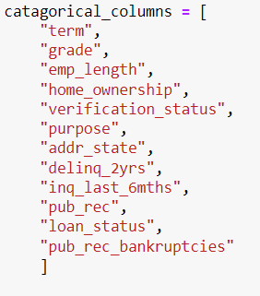
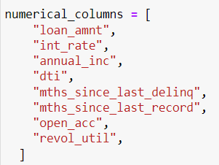
Data Analysis
The remaining columns after Data cleaning are divided into numerical and categorical variables.

Slide 10
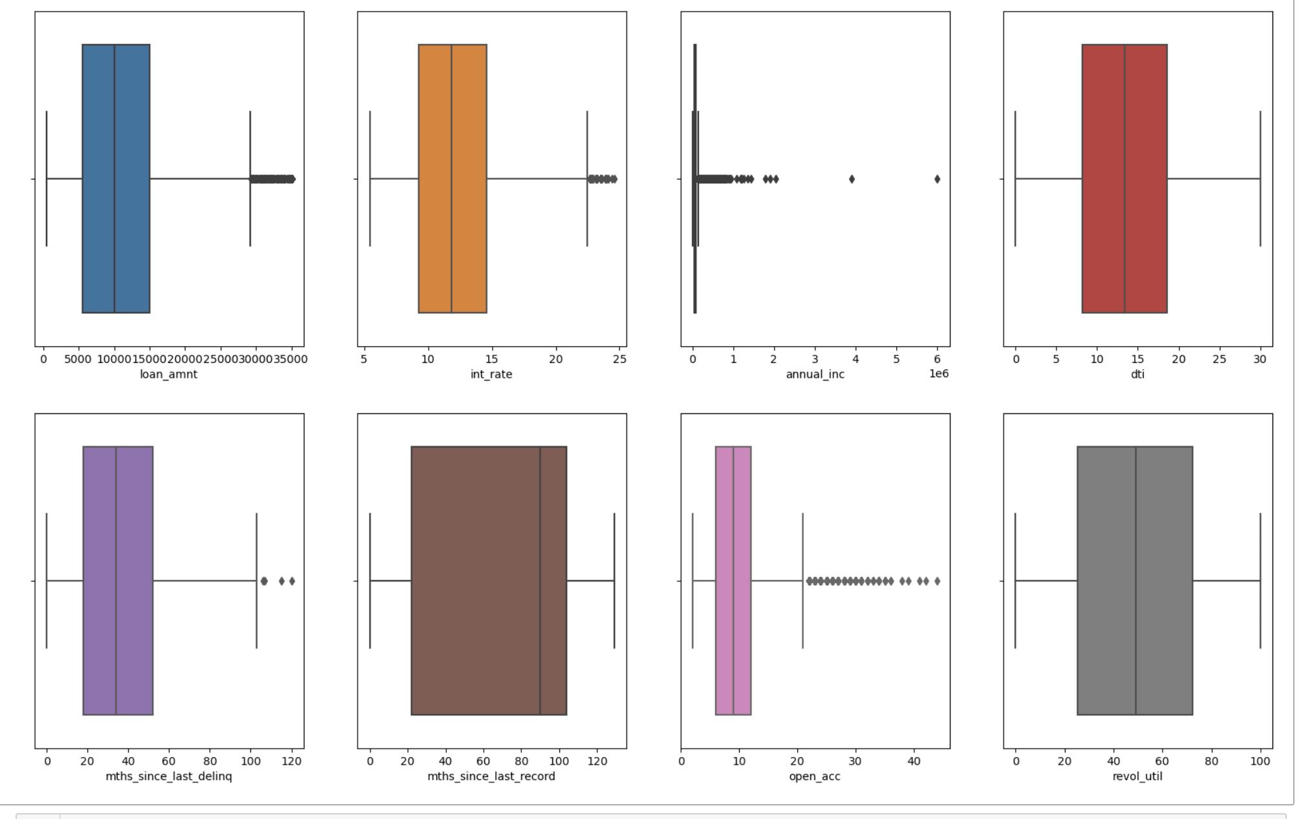
Outliers Treatment
Outliers in columns like annual_inc are removed as they mislead the analysis results.

Slide 11
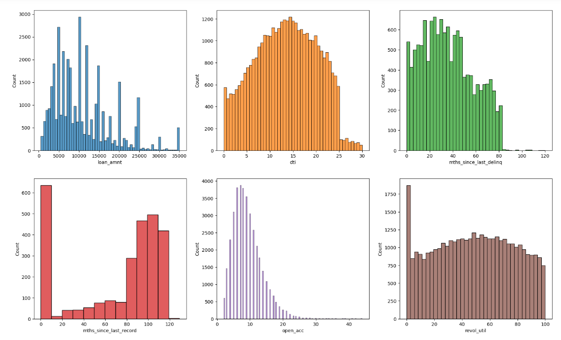
Univariate Analysis - Numerical Columns
These graphs depict the univariate analysis of numerical columns for the entire dataset.

Slide 12
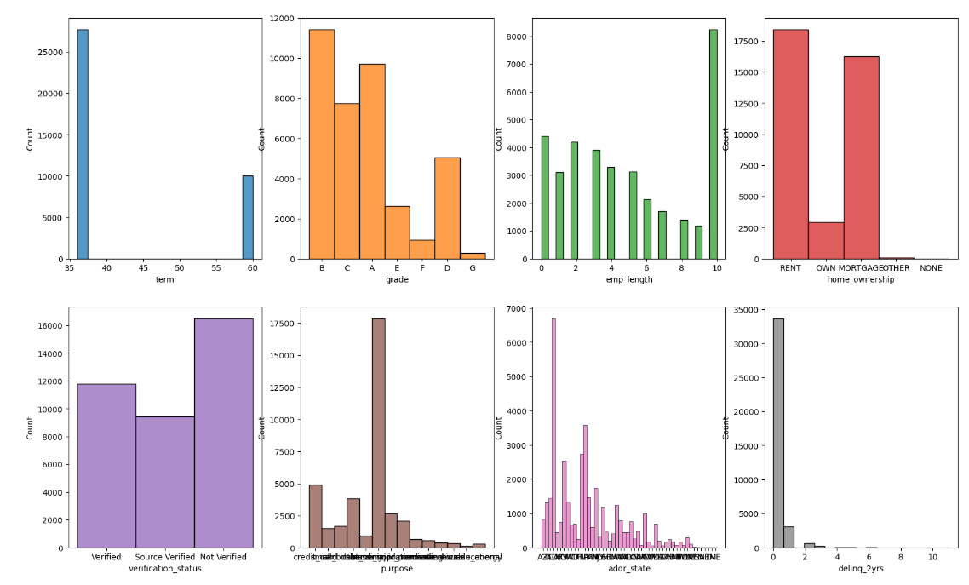
Univariate Analysis - Categorical Columns
These graphs depict the univariate analysis of catagorical columns for the entire dataset.

Slide 13
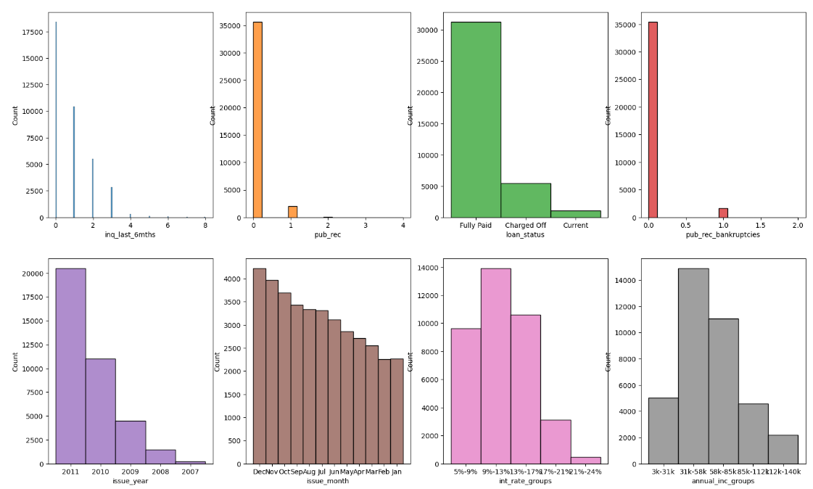
Univariate Analysis - Categorical Columns
These graphs depict the univariate analysis of categorical columns for the entire dataset.

Slide 14
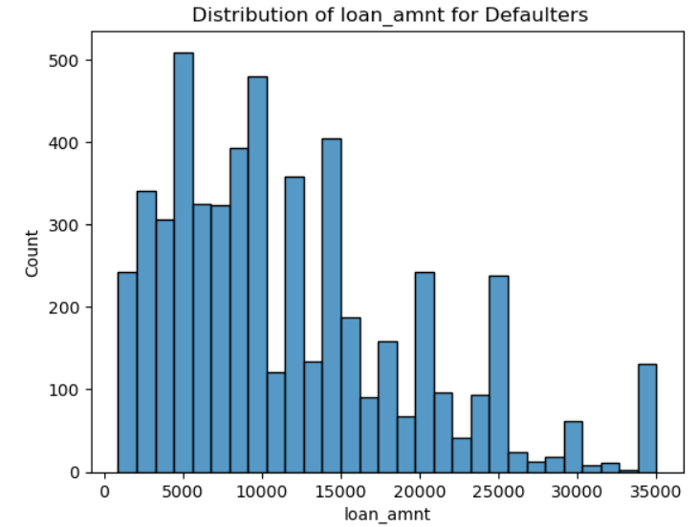
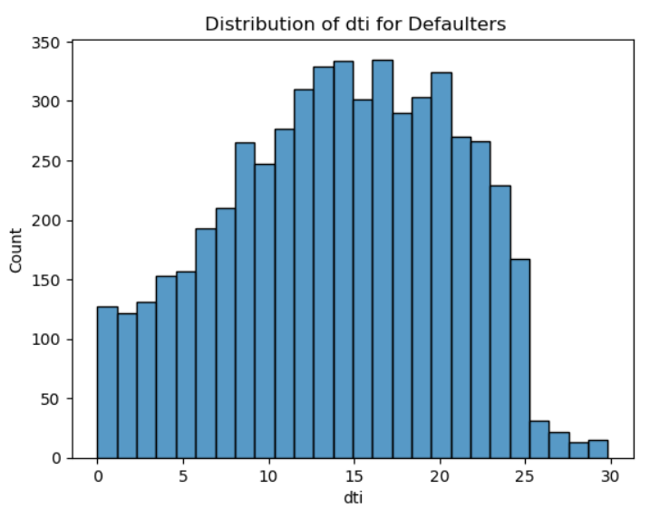
Univariate Data Analysis
As the loan amount increases, there is less count of defaulters
The debt to income ratio for defaulters is at it peak between 10 to 25%

Slide 15
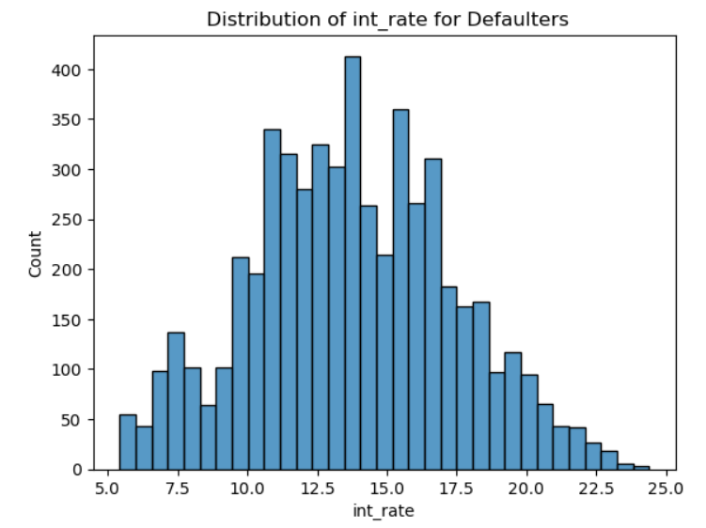
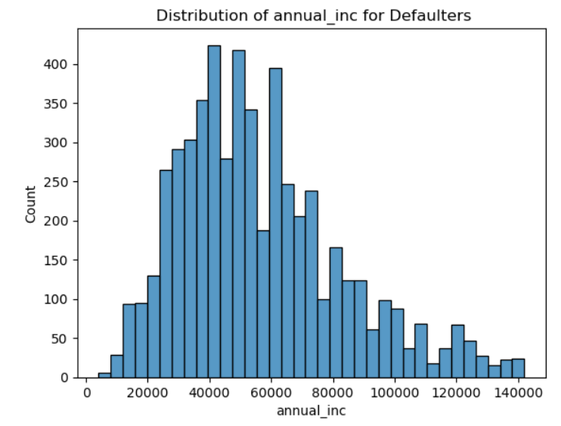
Univariate Data Analysis contd…
Most of the defaulters are the people whose loan interest rate is between 13 to 17%
The self reported annal income for most of the defaulters lies between 40k to 70k

Slide 16
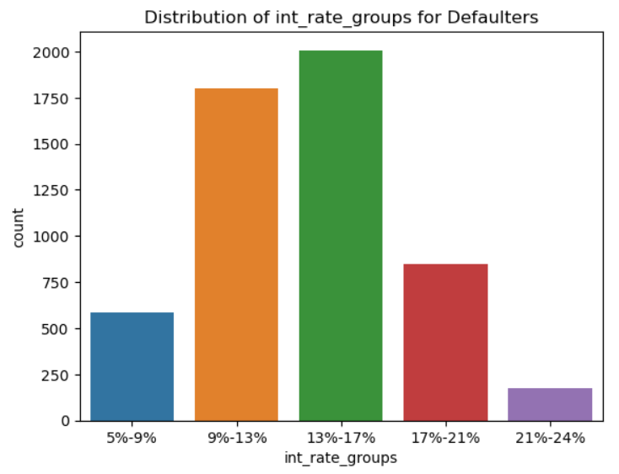
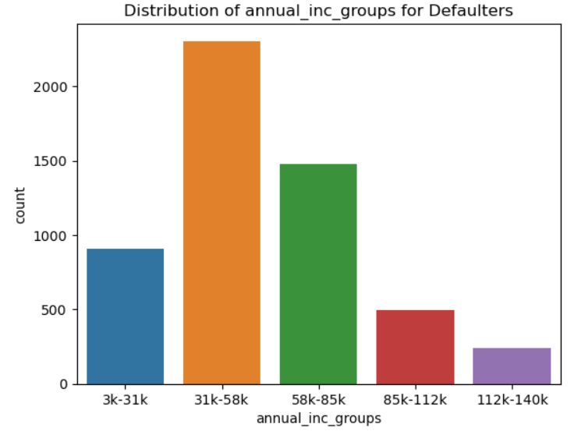
Univariate Data Analysis contd…
Most of the defaulters are the people whose loan interest rate is between 13 to 17%
The self reported annual income for most of the defaulters lies between 31k to 58k

Slide 17
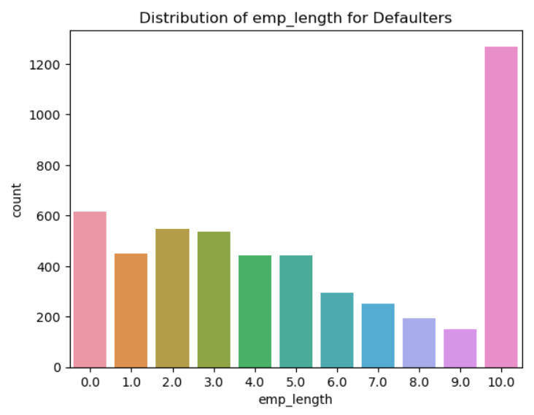
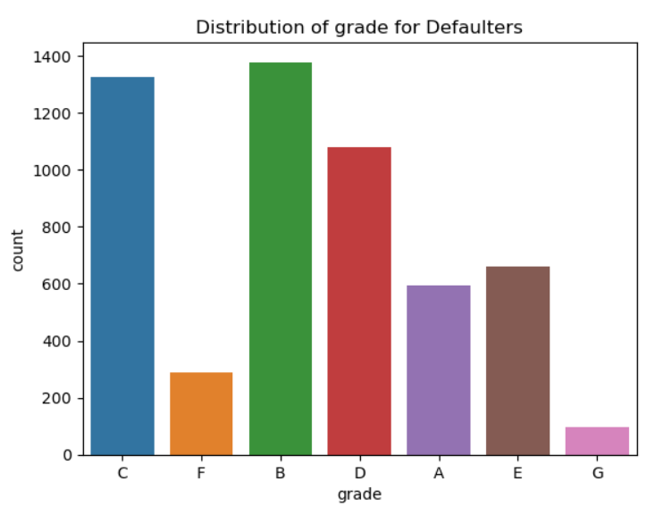
Univariate Data Analysis contd…
More defaulters are having the employment experience more than 10 years
Applicants with grade B and C are more defaulters compared to applicants of other grades.

Slide 18
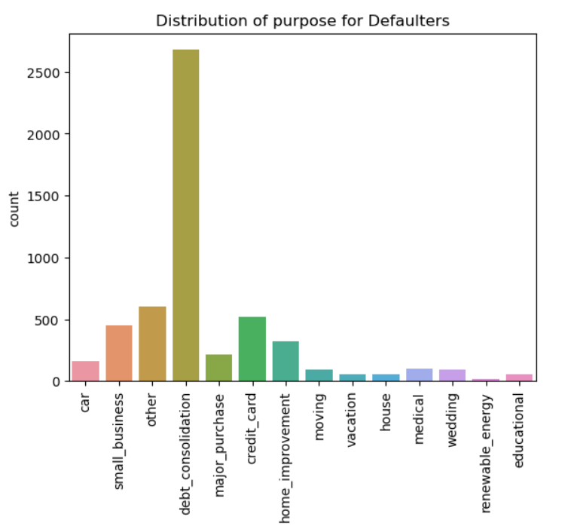
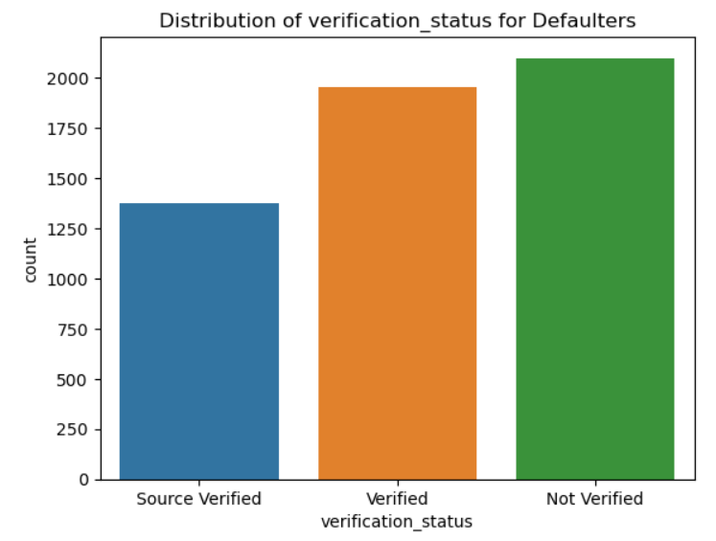
Univariate Data Analysis contd…
Applicants who has taken loans for debt_consolidation purpose are more prone to be defaulters.
Not Verified applicants are more prone to be defaulters.

Slide 19
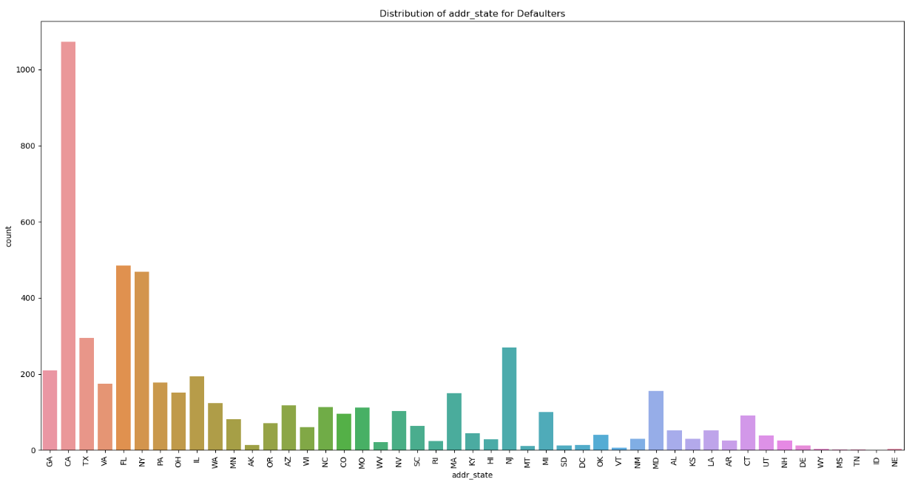
Univariate Data Analysis contd…
Applicants from states CA, FL and NY are more defaulters compared to other states.

Slide 20
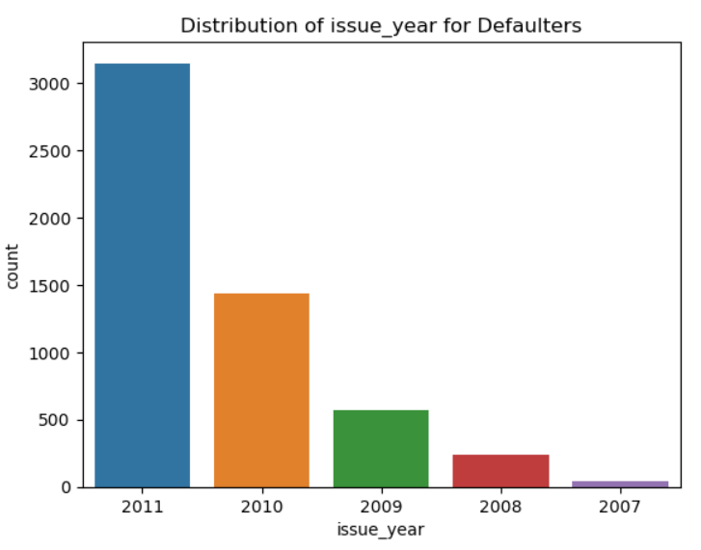
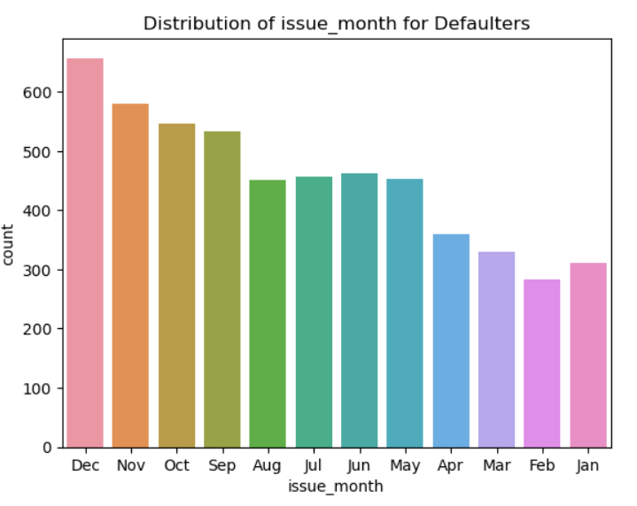
Univariate Data Analysis contd…
2011 has the highest defaulters.
Applicants who has taken loan towards the end of the year are more prone to be defaulters.

Slide 21
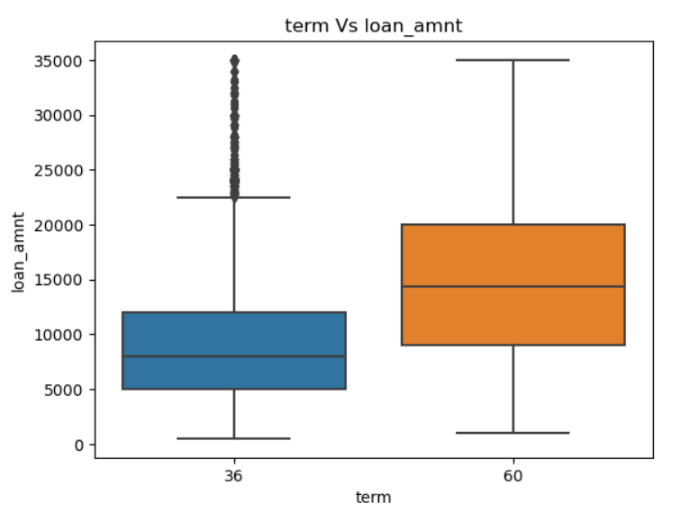
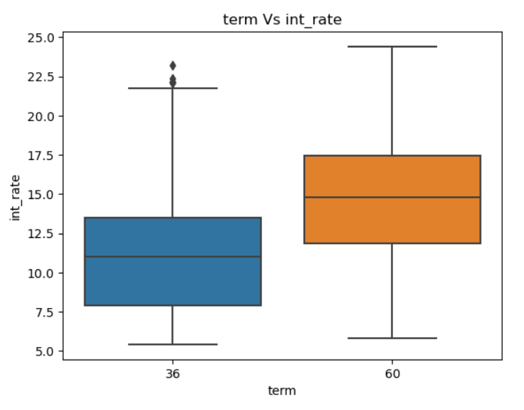
Bivariate Analysis
The applicants who opt for higher term are provided more loan amount at the same time they are charged with higher interest rates.

Slide 22
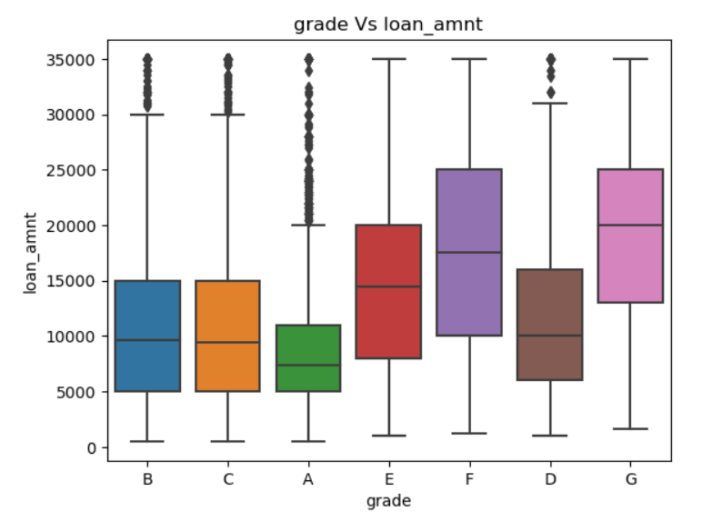
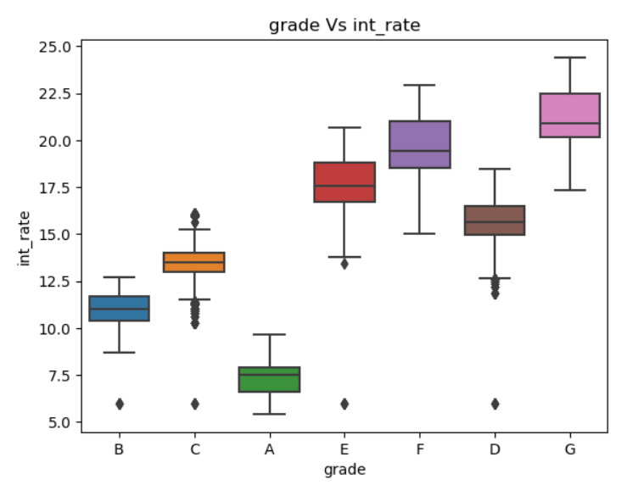
Bivariate Analysis contd…
The applicants who are of Grade ‘F’ and ‘G’ are provided higher loan amount with higher interest rates.

Slide 23
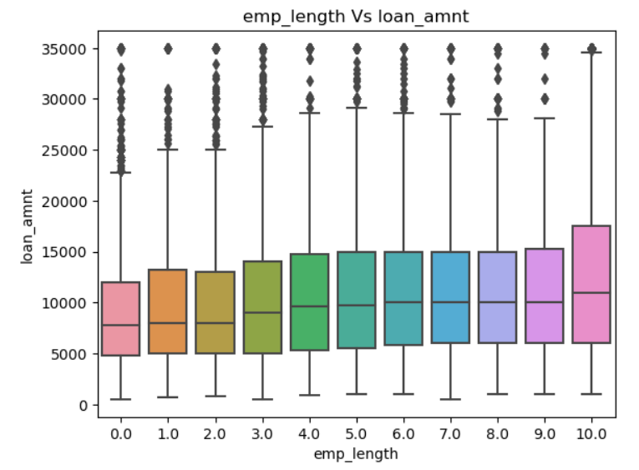
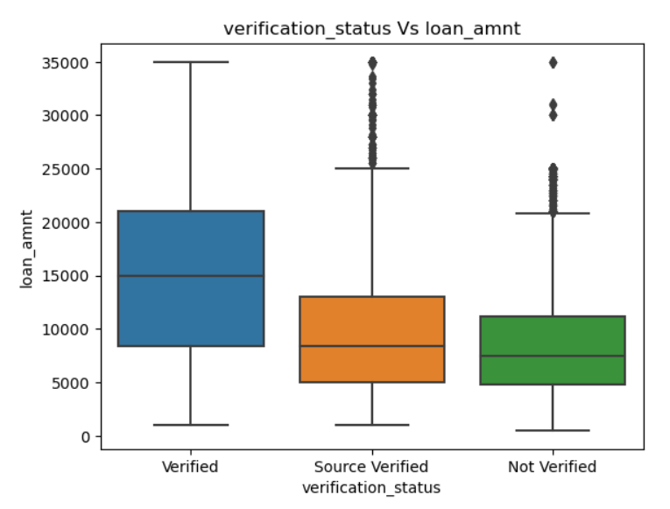
Bivariate Analysis contd…
The applicants who has 10 Plus years experience are offered higher loan amount.
Higher loan amount is provided with verification.

Slide 24
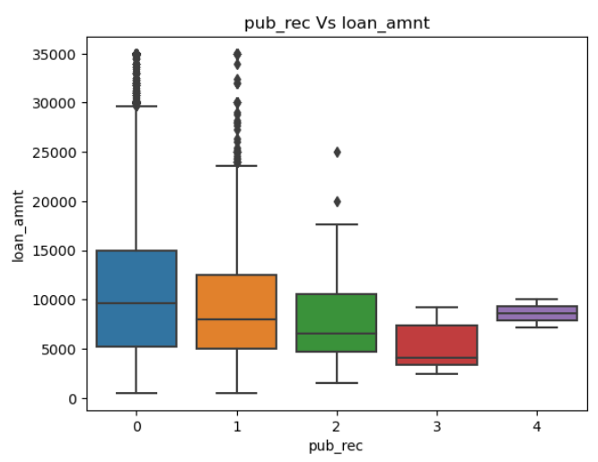
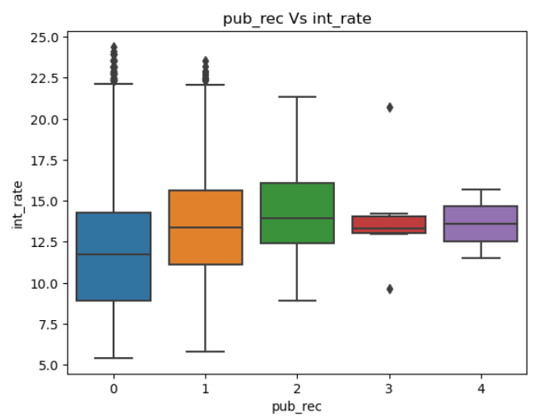
Bivariate Analysis contd…
The applicants who does not have any derogatory public records are provided more loan amount with less interest.

Slide 25
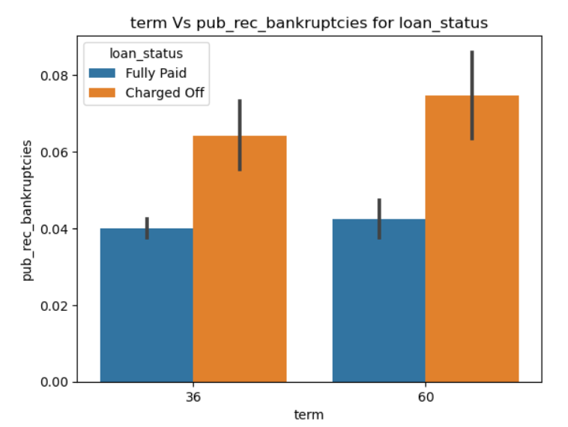
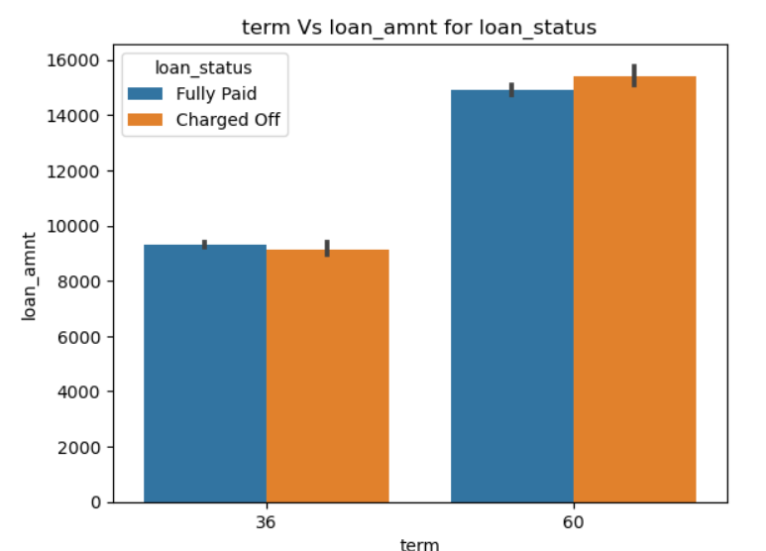
Loan Status Vs other columns
The applicants who defaulted for any term has more public recorded bankruptcies compared to the fully paid applicants.
Applicants who applied and defaulted have no significant difference in loan amount which means the applicants applying for long term has applied for more loan.

Slide 26
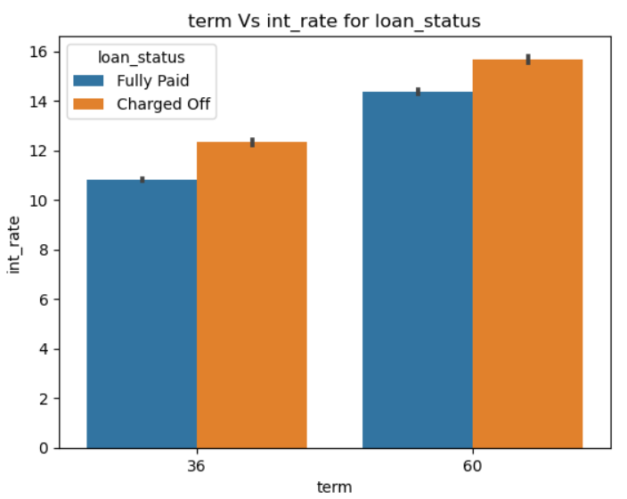
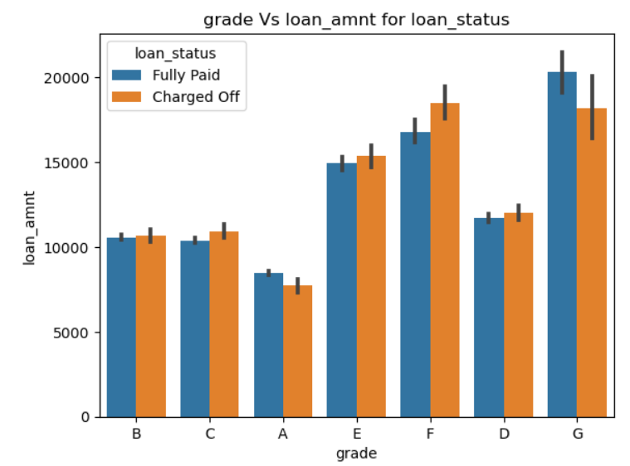
Loan Status Vs other columns
The more the term of loan the more is the interest rate and the more are the defaulters.
Applicants of F grade has taken more loan amount and are more defaulter compared to other grades.

Slide 27
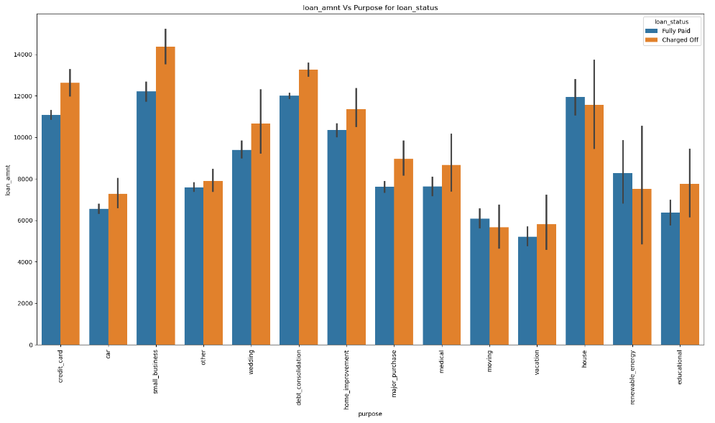
Loan Status Vs other columns
The applicants to has taken loans for small business purpose defaulted the most compared to other applicants

Slide 28
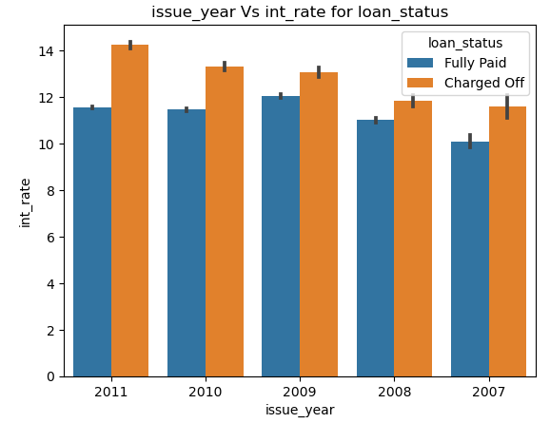
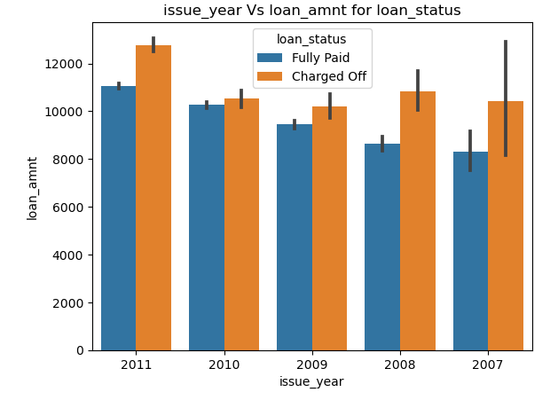
Loan Status Vs other columns
Due to the US financial crisis in 2011, higher loan amounts with higher interest rates are disbursed. Hence more defaulters are observed in case the country is facing any abnormal issues.

Slide 29
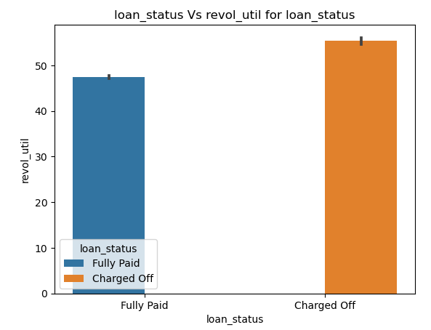
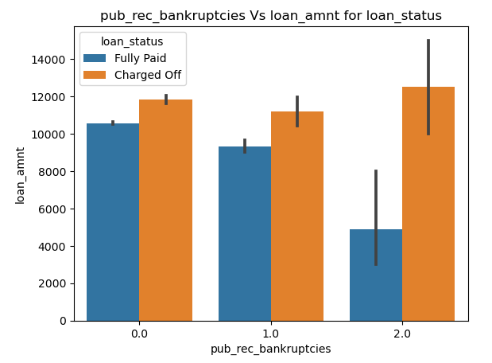
Loan Status Vs other columns
Applicants who has more bankruptcies are more prone to be defaulters.
Applicants who has more revolving line utilization rate are more prone to be defaulters.

Slide 30
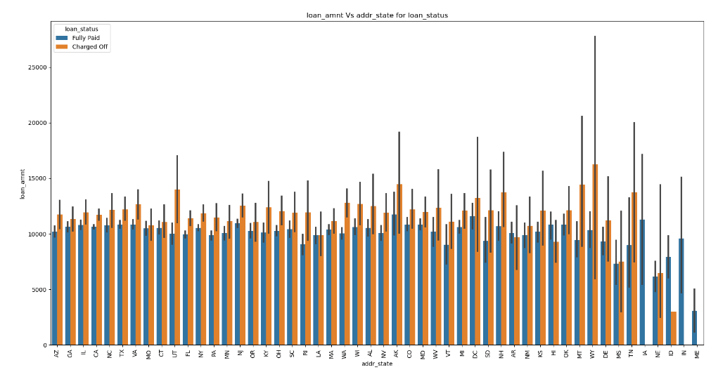
Loan Status Vs other columns
Among the applicants of different states, WY state people have take more loan amount and has more defaulters

Slide 31
Conclusion
The key attributes leading to applicants becoming defaulters are :
Applicants of F grade has taken more loan amount and are more defaulter compared to other grades. (Ref slide 26)
Loans taken for purpose Small business are more prone to be defaulters. (Ref slide 27)
If there are any natural or financial Crices there could be more defaulters among the people taking loan in this duration (Ref slide 28)
The self reported annual income for most of the defaulters lies between 31k to 58k. (Ref slide 16)
Applicants who have higher public derogatory records have chances to default but they are provided loans with higher interest rates.
Key Attributes:
Loan Purpose
Employee Grade
Annual Income
Public Recorded bankruptcies

